Slide 1
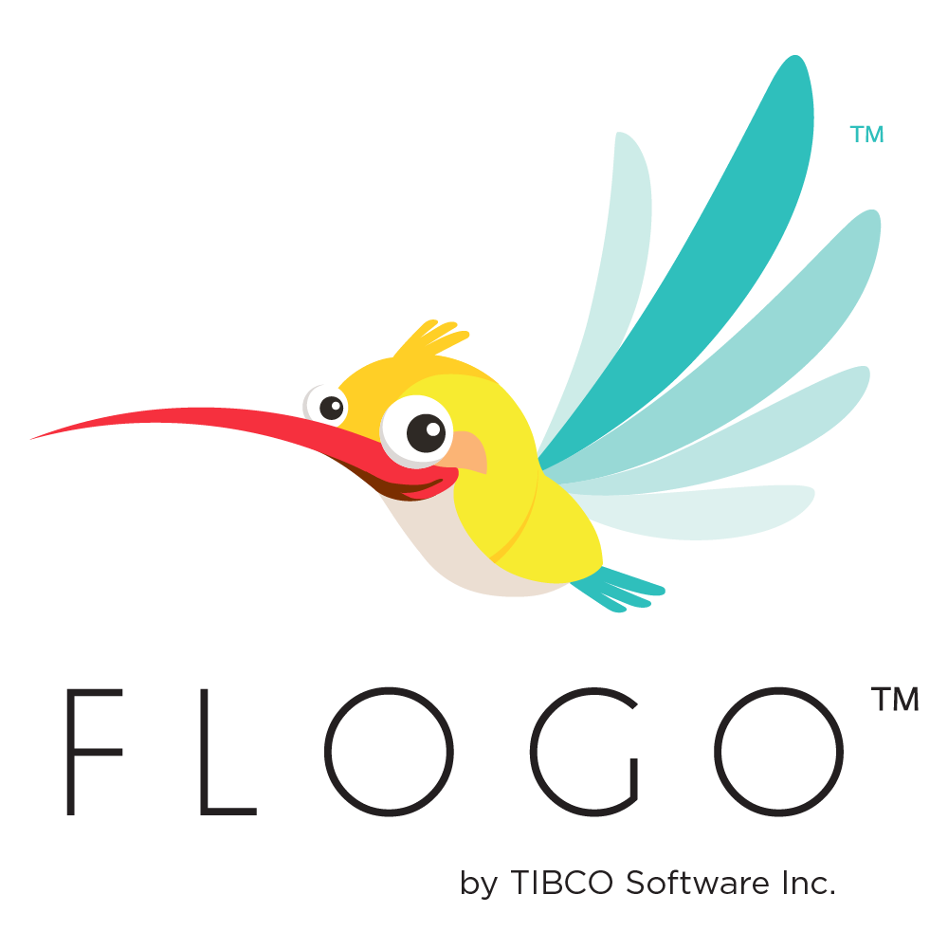
TIBCO FLOGO
Training Day 6
Trainer: Jaydeep
Date: 12/Jul/2023

Slide 2
Agenda
API
Build APIs
Use Swagger Specification
Use GraphQL
Use gRPC
Data Types Representation
LAB: Connecting TIBCO Cloud Applications
Create a Swaggerr App
Create a GraphQL App
Push gRPC App

Slide 3
Build API
Flogo® Enterprise lets you take an API-first development approach to implement APIs from a GraphQL schema or a Swagger 2.0 specification.
Once you upload a GraphQL schema or Swagger file, Flogo® Enterprise validates the file.
And if the validation passes, it automatically creates the Flogo® flows and trigger for you.

Slide 4
Use Swagger Specification
Flogo® Enterprise gives you the option to create the Flogo app logic (flows) by importing a Swagger 2.0 specification file.
Simply drag and drop a Swagger file into the Flogo Enterprise UI and the flows for your app automatically get created based on the definitions in the Swagger file that you uploaded.
Flogo® Enterprise validates file extension and contents of the file.
If validation passes, it creates the flows based on definitions in the file. One flow gets created for each method and path combination defined.

Slide 5
Use GraphQL
Flogo® Enterprise allows you to create GraphQL triggers by dragging and dropping your GraphQL schema file or by navigating to the file.
Flogo® Enterprise validates file extension(should be .gql or .graphql) and contents of the file.
If it passes validation, A flow gets automatically created for every query and mutation type in your schema. Then open the flow and define data which flow will return.
This saves the time and effort to programmatically define data structures on the server.

Slide 6
Use gRPC
You can use gRPC by adding the gRPC trigger in a flow or by uploading a .proto file to the flow.
The gRPC trigger acts as the server to the gRPC clients. You create the trigger when you create a flow that gets attached to the trigger.
You can attach new flows to the existing gRPC trigger by hovering over the trigger and selecting New flow.
gRPC flows are created from the definitions in the .proto file that you upload to Flogo® Enterprise.
The out-of-the-box gRPC trigger in Flogo® Enterprise uses a .proto file to define one or more services and the various Remote Procedure Calls (methods) under the service.

Slide 7
Data Types Representation
JSON does not support all data types supported in protobuf.
Hence, Flogo® Enterprise converts some of the data types to an equivalent data type in JSON.

Slide 8
LAB
Build API using Swagger
Build API using GraphQL
Build API using gRPC
Required Software:
GraphQL: https://chrome.google.com/webstore/detail/graphiql-extension/jhbedfdjpmemmbghfecnaeeiokonjclb
Postman

Slide 9
Questions?

